Slide 1
Automatic Geometry Correction and Enhancement
Digital Image Processing Project Proposal
王卓扬
2023.04.12

Slide 2
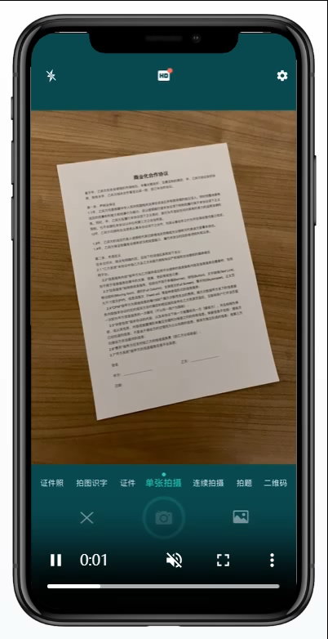

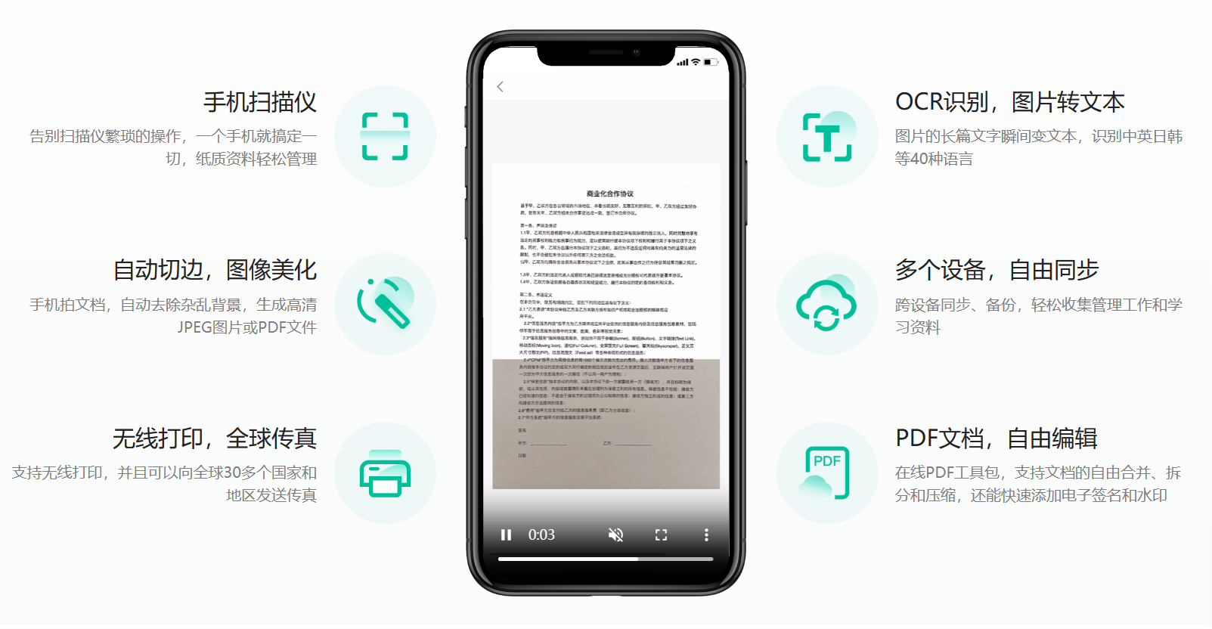
Intro
Camscanner

Slide 3
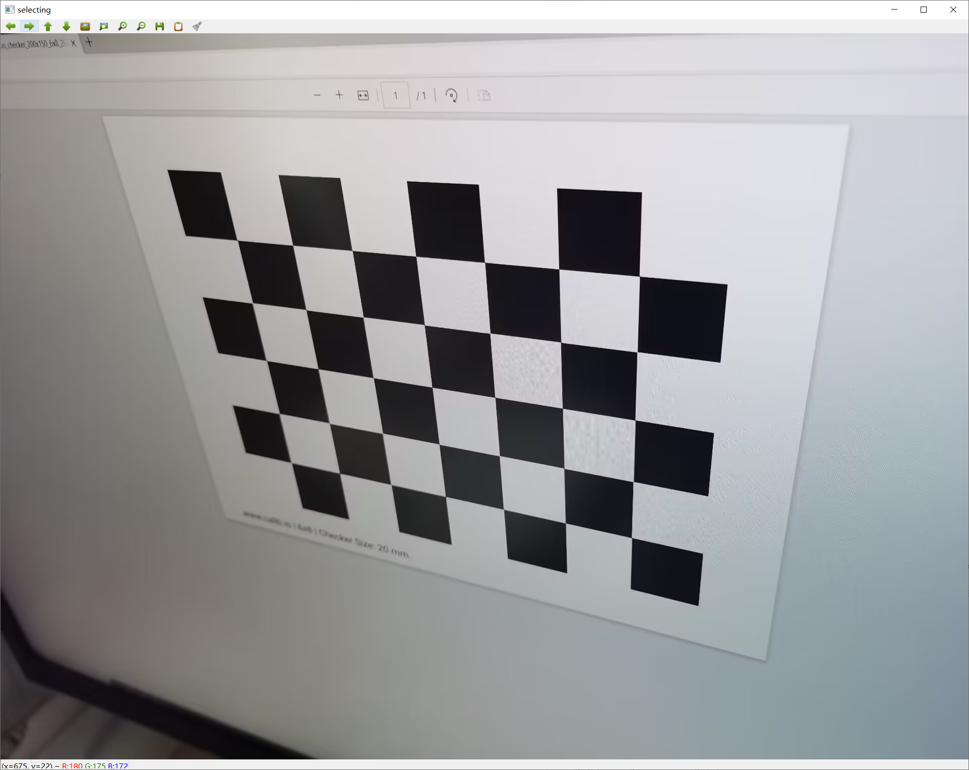
Intro
Automatic edge slicing

Slide 4
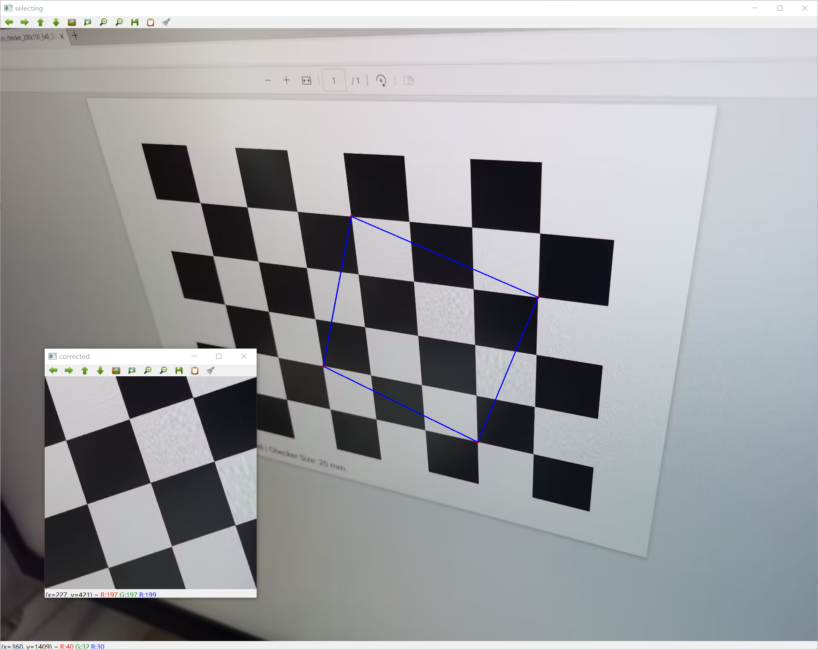
Intro
Geometry correction

Slide 5
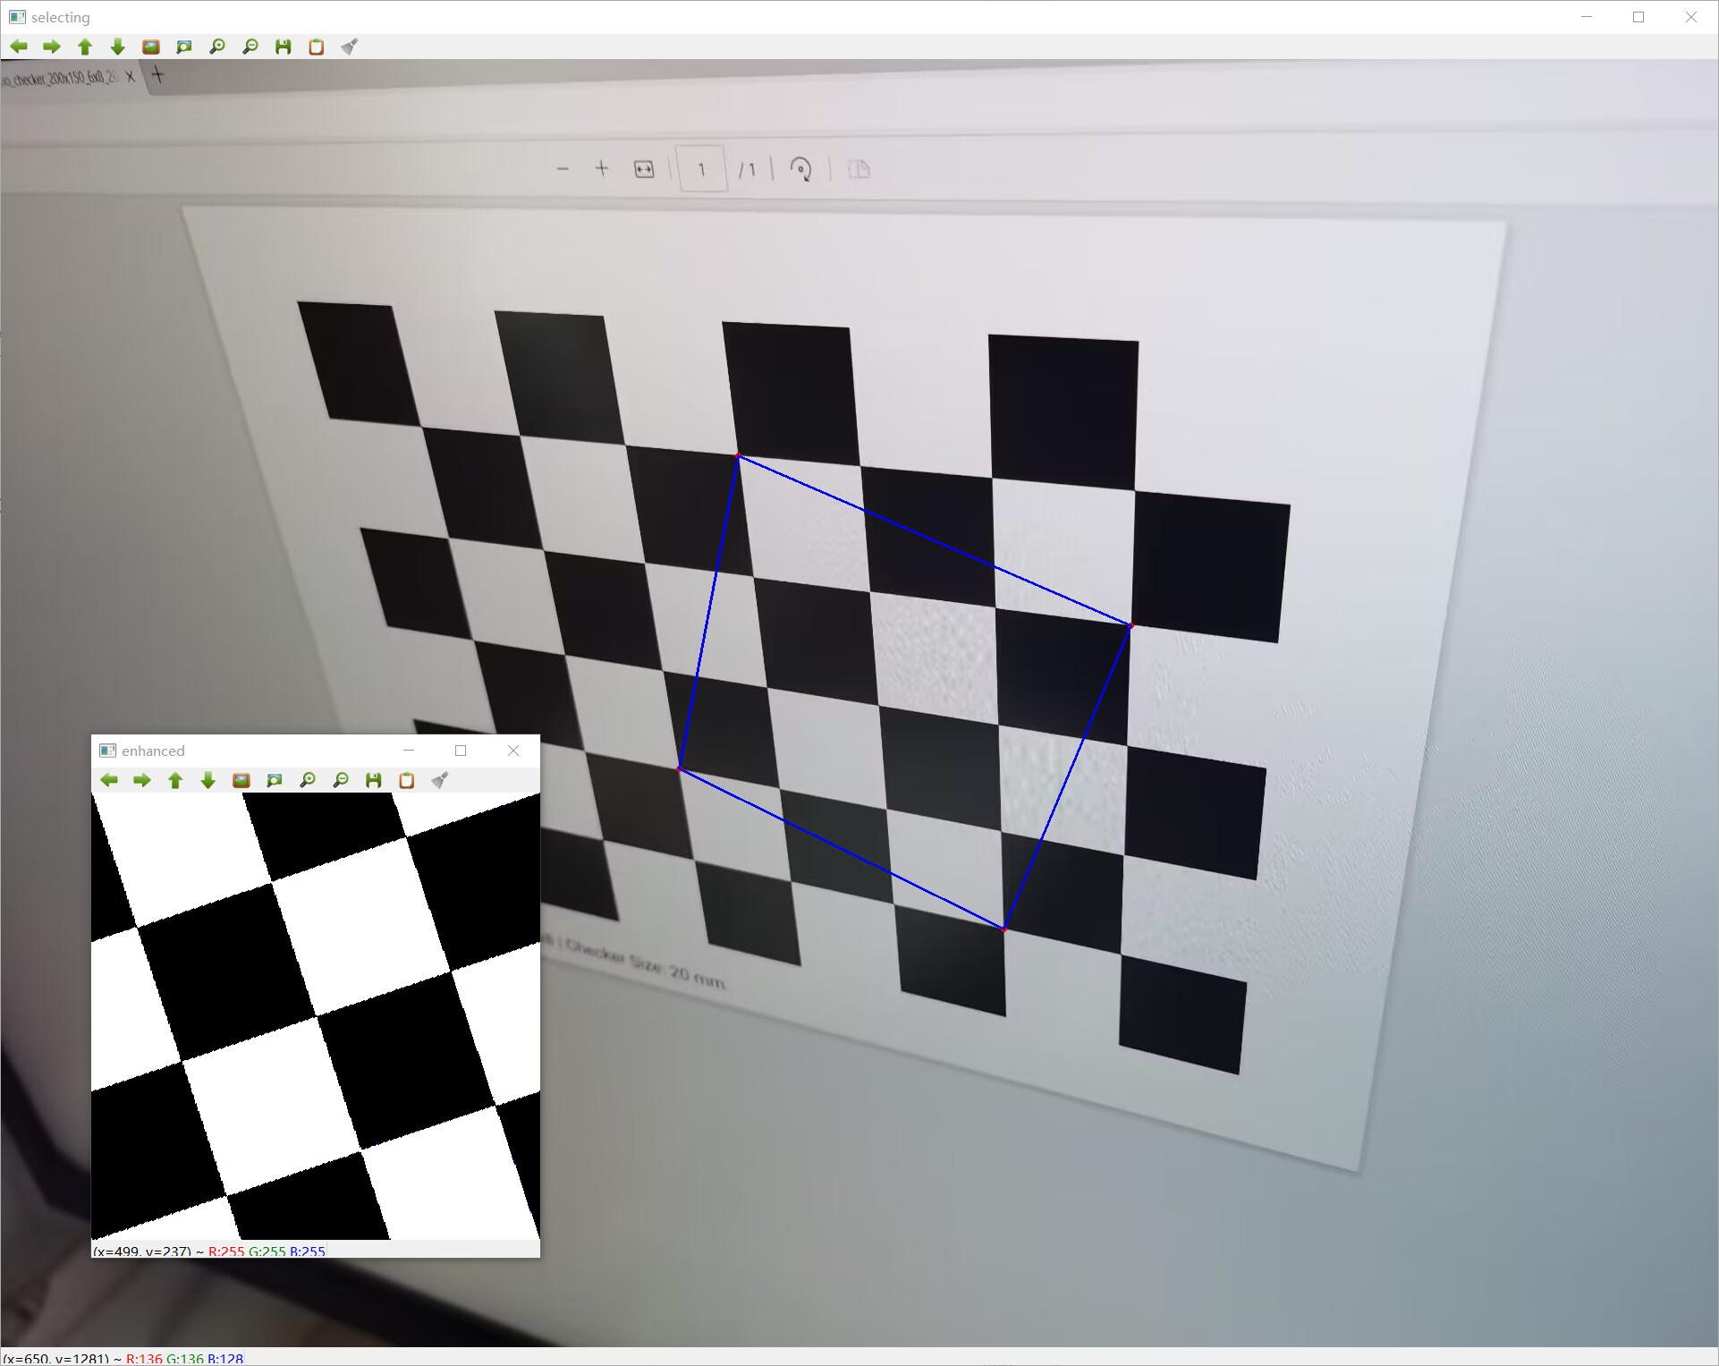
Intro
Enhancement

Slide 6
Application
Basic
Document scanning
Image restoration
Image stitching
Pre-processing for OCR / …
…
Practical APP for free
…

Slide 7
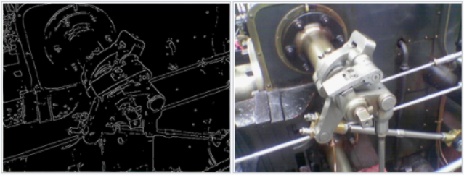
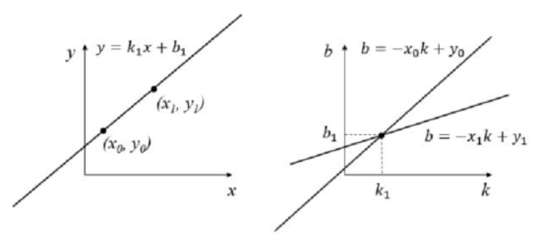
Methodology
Automatic edge slicing
Pre-processing
Defocus correction
Distance model
Content fuzzification
Line segment detection
Edge detection
Canny
Hough transformation
(Or) …
Rectangle area detection
Evaluation
Sort
Combination

Slide 8
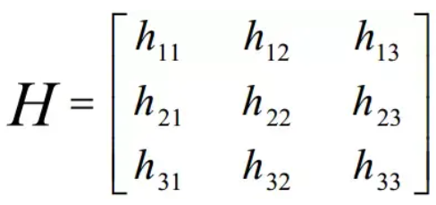
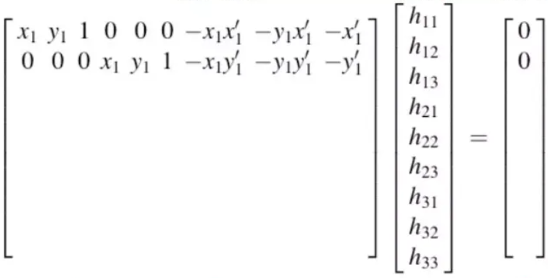
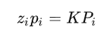
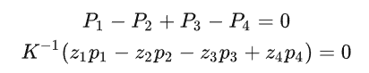
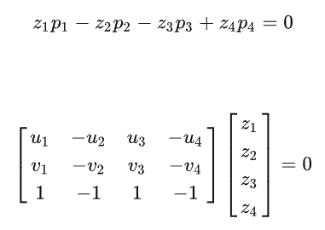
Methodology
Geometry correction
Homography transformation
Homography matrix
Direct linear transformation
Scale distortion correction
Camera model
Camera calibration
Nullspace solution
Enhancement
Sharpening
Brightening
Binarization
…

Slide 9
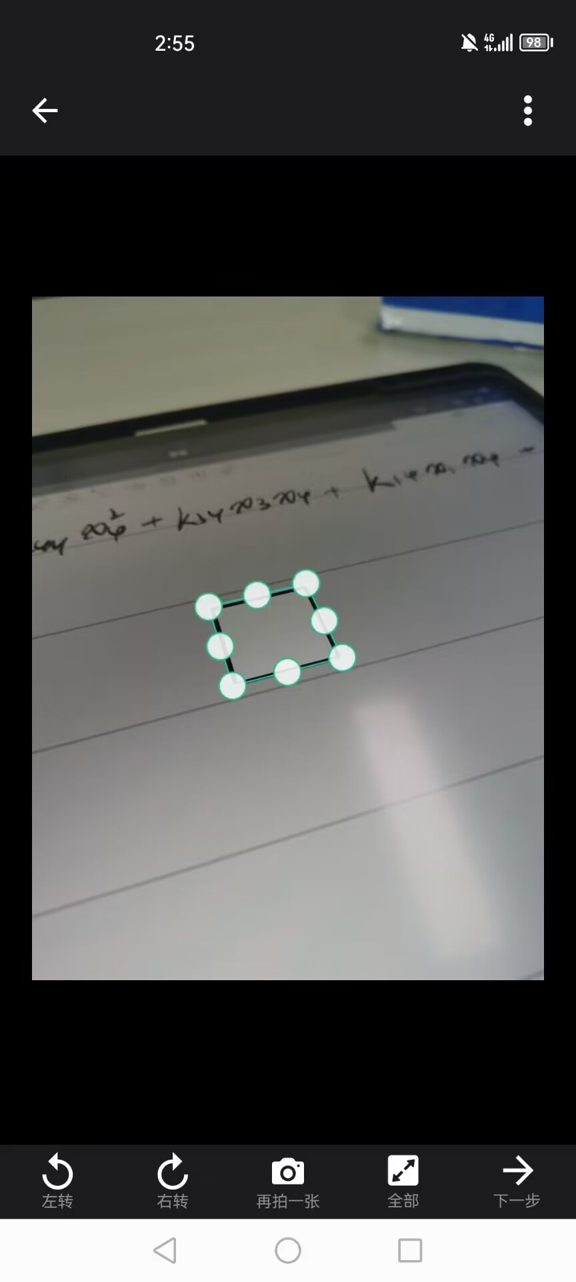
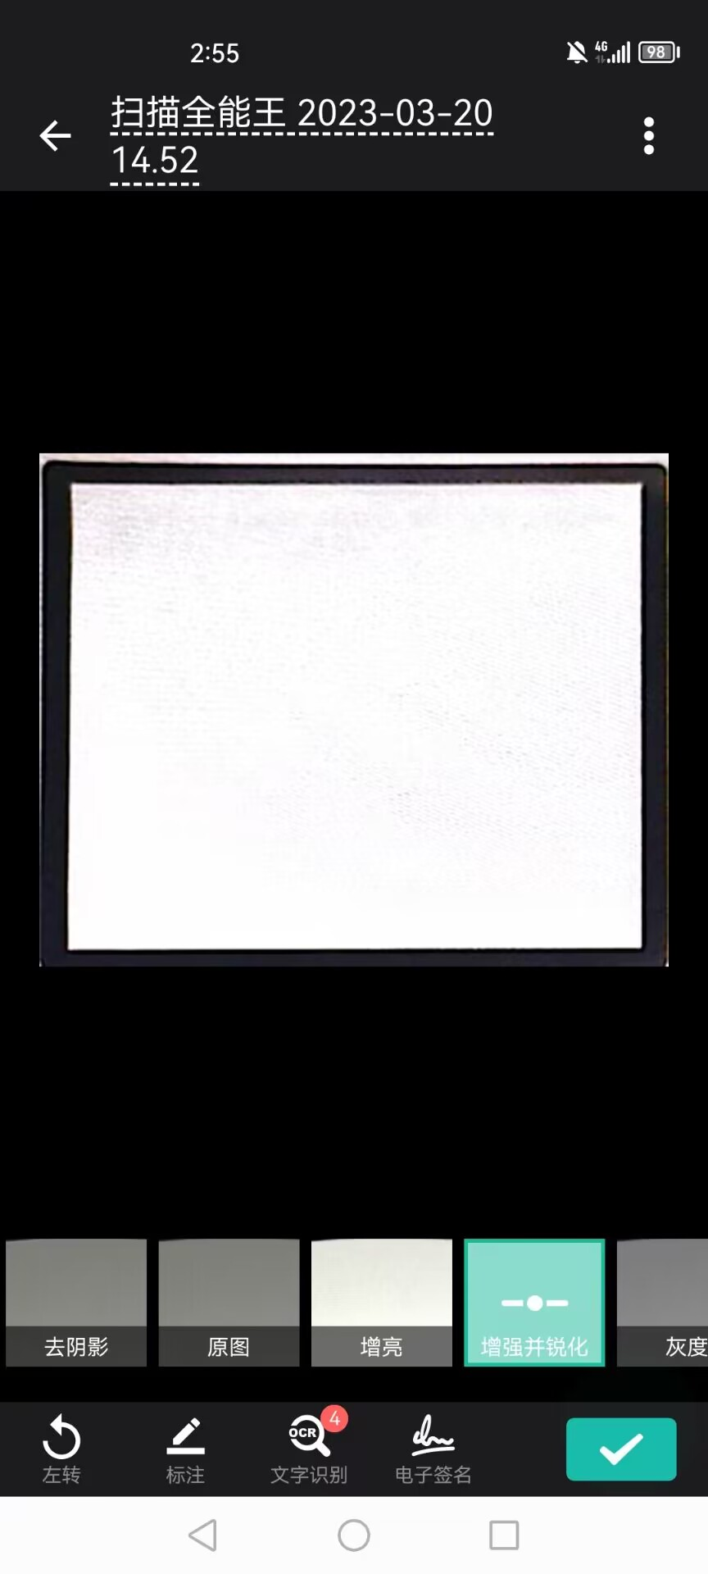
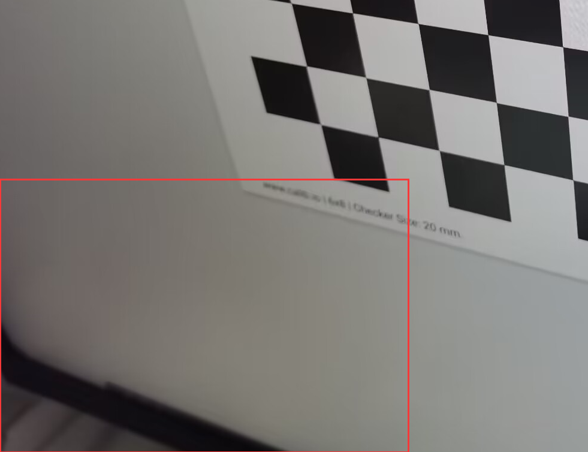

Goals
Fundamental
Reproduce the technique
Improvement
Better edge slicing algorithm
Refined line segment detecting and connecting
Scale distortion
Vectorization (performance)
…
Extension
Photometric calibration / Shadow processing
Defocus correction
Curved surface
Multi-homography transformation
(Or) Modeling the surface
Planer AR
Optical character recognization
…

Slide 10
Automatic Geometry Correction and Enhancement
Thank you.
2023.04.12

